Slide 1

Note: The data and information in this document is reflective of a hypothetical situation and client. This document is to be used for KPMG Virtual Internship purposes only.
Sprocket Central Pty Ltd
JAIGANESAN N
APRIL 2023

Slide 2
Note: The data and information in this document is reflective of a hypothetical situation and client. This document is to be used for KPMG Virtual Internship purposes only.
Agenda
Introduction
Data Exploration
Model Development
Interpretation

Slide 3
Note: The data and information in this document is reflective of a hypothetical situation and client. This document is to be used for KPMG Virtual Internship purposes only.
Introduction
PROBLEM STATEMENT :
Sprocket Central Pty Ltd is a bikes and cycling accessories company, has given us a new list of 1000 customers with their demographics and list of attributes. This new list of customers had no previous transaction with this company.
GOAL:
To Find the Potential insights from the dataset and Focusing on targeted customers .Improve performance by focusing more on high value customers.
DATASETs:
Sprocket Central Pty Ltd provided us 3 datasets: Customer Demographic, Customer Addresses, Transactions data, New Customer List (Target Customer List).
STEPS TO BE TAKEN:
1.DATA CLEANING – Clean Data for better Output.
2.DATA TRANSFORMATION
3.DATA EXPLORATION

Slide 4
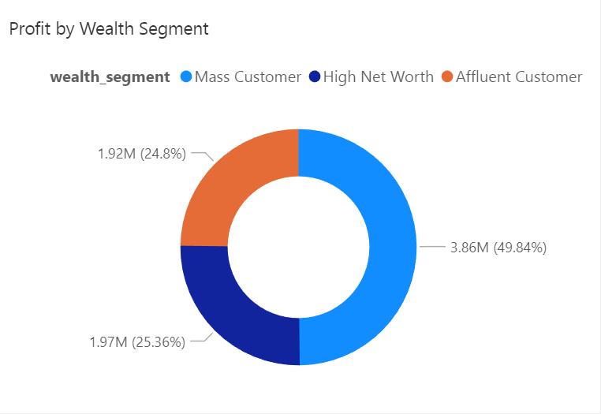
Total Profit based on Wealth Segment of customers
Note: The data and information in this document is reflective of a hypothetical situation and client. This document is to be used for KPMG Virtual Internship purposes only.
Data Exploration
Insights:
Nearly 50% profit is made by Mass customer segment. Among three Mass Customer holds half stacks. And other two approximately hold each 25 %.

Slide 5
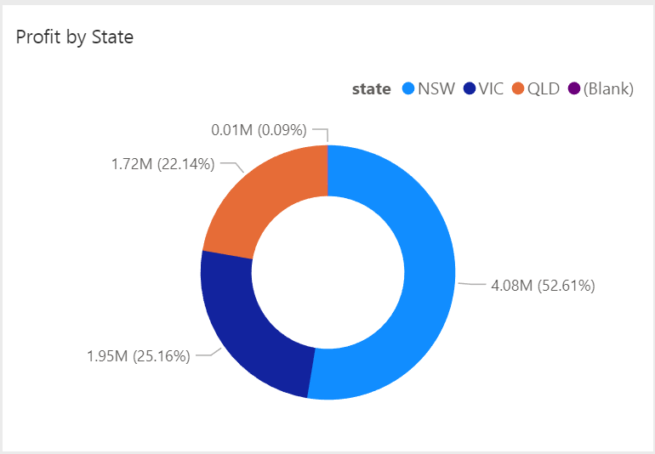
Note: The data and information in this document is reflective of a hypothetical situation and client. This document is to be used for KPMG Virtual Internship purposes only.
Data Exploration
Total Profit based on States in Australia
Insights:
New Sounth Wales (NSW) Customers are among the three states hold more than 50 % of the profit share.
Place any supporting images, graphs, data or extra text here.

Slide 6
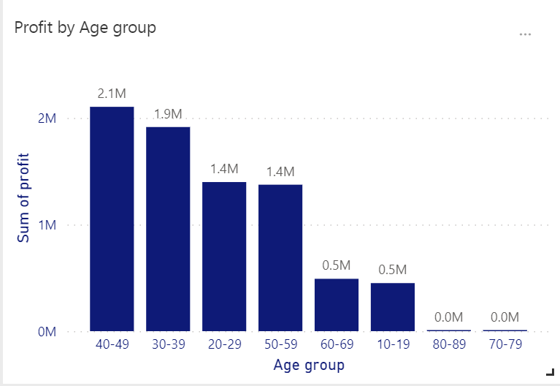
Note: The data and information in this document is reflective of a hypothetical situation and client. This document is to be used for KPMG Virtual Internship purposes only.
Data Exploration
Total Profit based on different Age Groups
Insights:
In terms of recent transaction history customers between 30 and 49 age are most profitable compares to other age group. This age group amounts to $ 40 Lakhs+ profit.
Place any supporting images, graphs, data or extra text here.

Slide 7
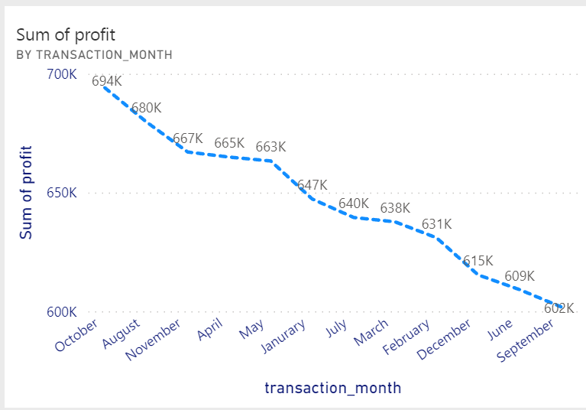
Note: The data and information in this document is reflective of a hypothetical situation and client. This document is to be used for KPMG Virtual Internship purposes only.
Data Exploration
Total Profit based on Month :
Insights :
In terms of recent transaction history October, August, November months are most profitable month in total years.
Place any supporting images, graphs, data or extra text here.

Slide 8
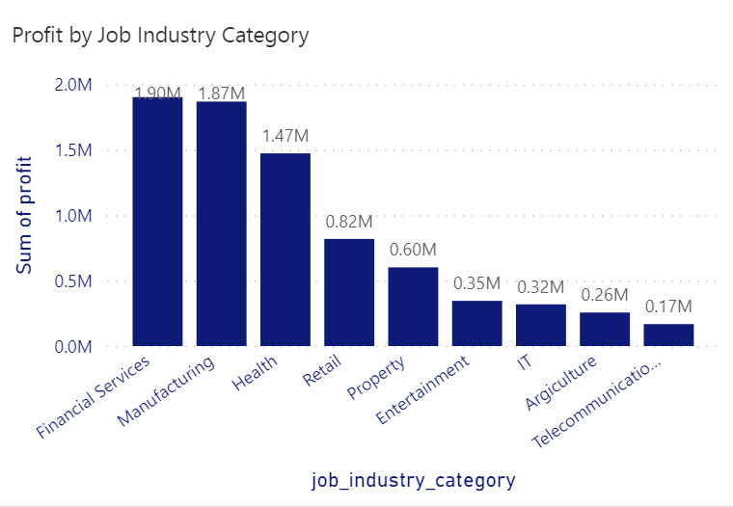
Note: The data and information in this document is reflective of a hypothetical situation and client. This document is to be used for KPMG Virtual Internship purposes only.
Data Exploration
Total Profit based on customers Industry
Insights:
The customers related to Financial Service and Manufacturing showing most profit with $37 lakhs + profit.
Place any supporting images, graphs, data or extra text here.

Slide 9
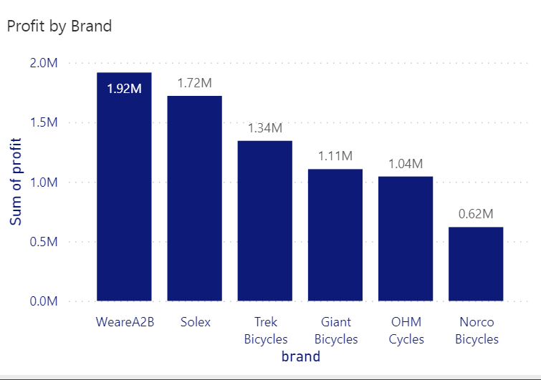
Note: The data and information in this document is reflective of a hypothetical situation and client. This document is to be used for KPMG Virtual Internship purposes only.
Data Exploration
Most purchased brands among customers
Insights:
WeareA2B, Solex Brands made $36+ lakhs profit. These Brands have 40 %
Profit stack.
Place any supporting images, graphs, data or extra text here.

Slide 10
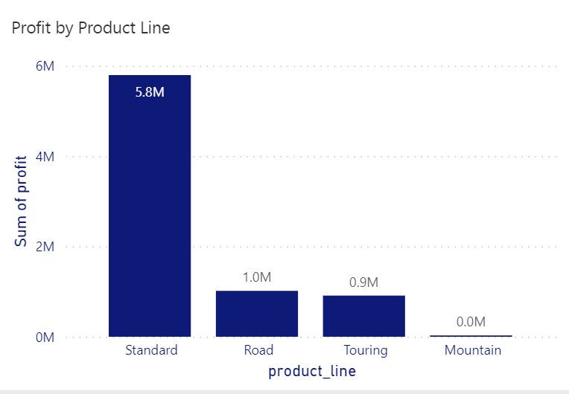
Note: The data and information in this document is reflective of a hypothetical situation and client. This document is to be used for KPMG Virtual Internship purposes only.
Data Exploration
Most purchased products among customers
Insights:
Standard product are most buyable products by customers among the other product with more than 10000 + transactions took place.
Place any supporting images, graphs, data or extra text here.

Slide 11
Note: The data and information in this document is reflective of a hypothetical situation and client. This document is to be used for KPMG Virtual Internship purposes only.
Model Development :
Marketing team should deploy the targeted model based on :
Customer between age 30 and 49.
Customers living in New South Wales.
Customers in the Mass Consumer Segment.
Customers in the year between August, October, November in 2nd and 3rd quarter.
Customers related to Financial Services and Manufacturing Industries.
WeareA2B , Solex brands and Standard product as the top priority.

Slide 12
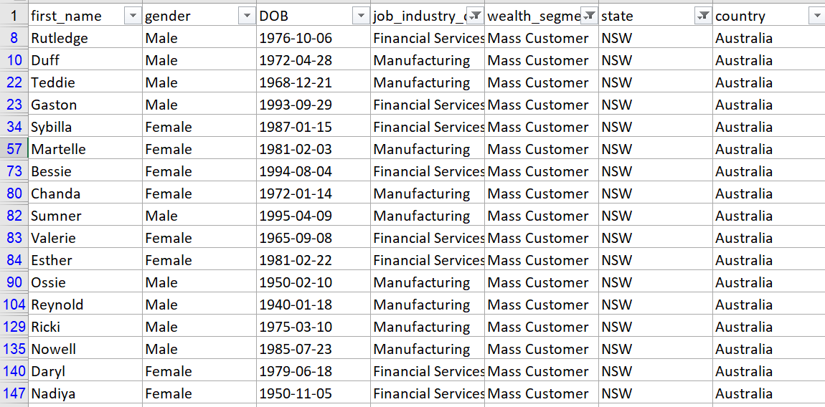
Note: The data and information in this document is reflective of a hypothetical situation and client. This document is to be used for KPMG Virtual Internship purposes only.
Interpretation
After filtering the targeted customers from the New Customer List, it will look like below

Slide 13
THANK YOU

